Slide 1
MSCA 32009
Health Analytics
COVID Twitter NLP
Group 8: Beca Wang, Elly Yang, Nimo Man
Date: Mar 18, 2021
Notes:
hi everyone, we are team 8, my name is Nimo, and I’m with my teammates Beca & Elly today to share our results from the covid twitter nlp analysis.

Slide 2
Data Files
I. Exploratory Data analysis | II. Topic Modeling | III. Sentiment Analysis
Places.csv
Shape: (1369, 8)
Useful cols:
[‘country’, ‘geo.bbox’]
Geospatial implementation: map # tweet across the world
Users.csv
Shape: (46152, 5)
Useful cols (after cleaning):
[‘author_id’, ‘self_input_location’, ‘username’]
Merge with data.csv
Data.csv
Shape: (23838, 12)
Useful cols (after cleaning):
[‘tweet_id’, ‘author_id’, ‘created_at’, ‘language’, ‘text’]
Notes:
Here are the three files we need to further look at. The places data includes the geolocation of each person. The users data give us the authors’ unique id and their self input location, which will not be used since it was much more messy than the location provided in the places dataset. Finally, the main data give us the unique tweet id, author id and most importantly, the text. It can be merged with the previous users data, joined on author id.

Slide 3
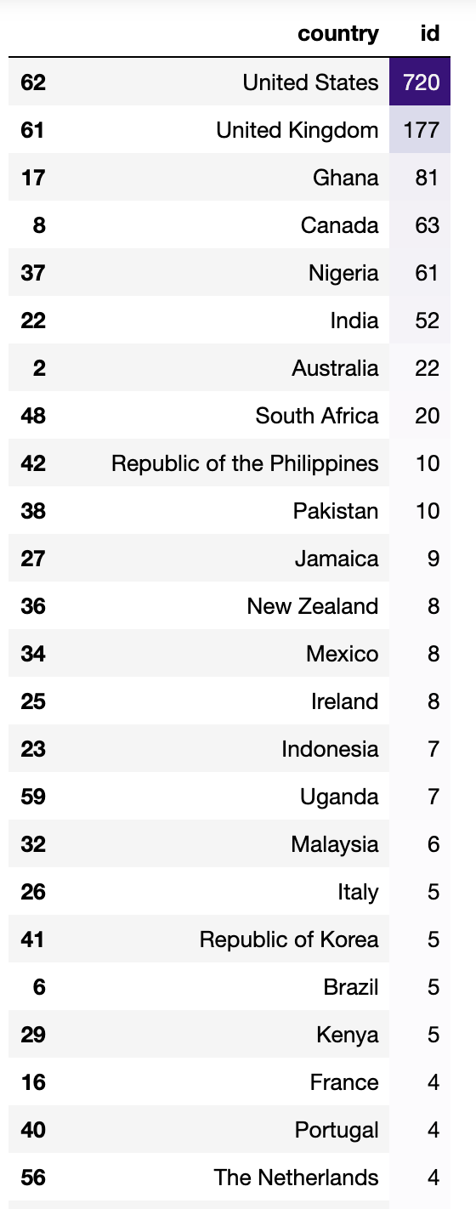
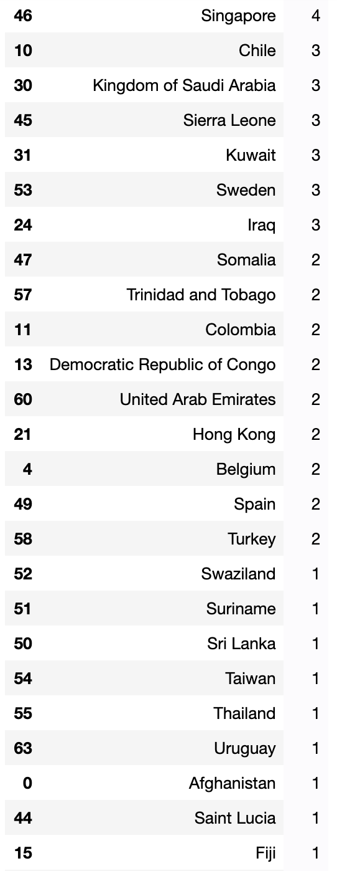

Places.csv: Country count & Geospatial
I. Exploratory Data analysis | II. Topic Modeling | III. Sentiment Analysis
Notes:
First, let’s dig into the places data. From the left graphs, we can see most people tweet in the US, followed by the United Kingdom. The right short video just show a more direct distribution of users. You can zoom in and zoom out to play with it

Slide 4
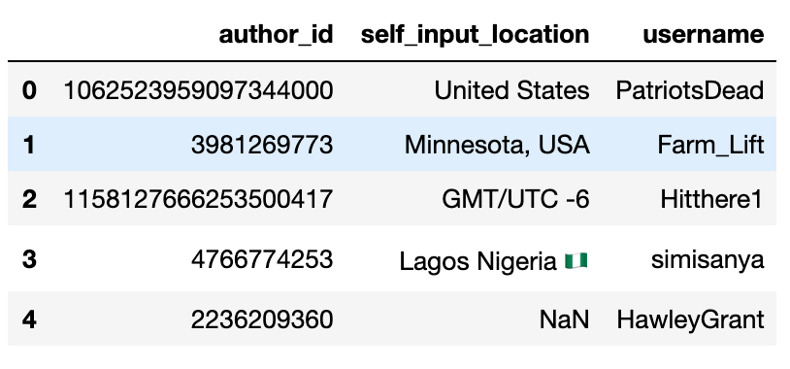
Users.csv: selecting useful columns
I. Exploratory Data analysis | II. Topic Modeling | III. Sentiment Analysis
Notes:
Moving on to the users data, we only keep three variables that can be further merged to the final data

Slide 5
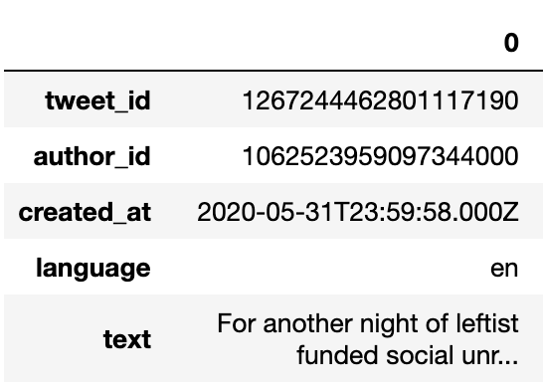
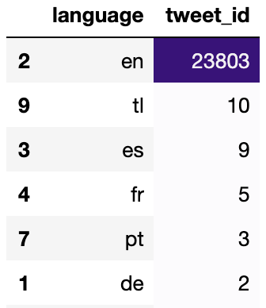
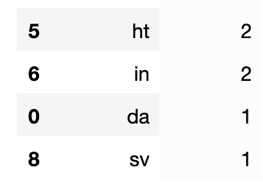
Data.csv: selecting useful col & language count
I. Exploratory Data analysis | II. Topic Modeling | III. Sentiment Analysis
Data after cleaning
COUNT Tweet’s language & Sort by frequency
Notes:
Here, we also clean the data file and change the variable name to a more understandable way. Also, we can see English dominate among all the languages on the right graph.

Slide 6
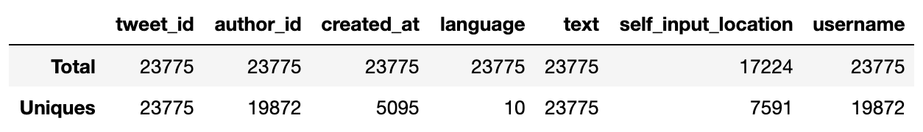
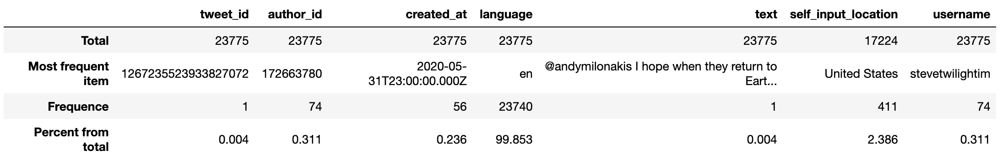
Merge users.csv & data.csv + EDA
I. Exploratory Data analysis | II. Topic Modeling | III. Sentiment Analysis
MERGE
Data.csv left join with Users.csv, on “author_id”
Unique values
Missing values
Only the “self_input_location”, count for 27.55%
Most frequent values
Notes:
Finally, we merged the users.csv and data.csv to our final data. You can see the unique values and frequent values on the right

Slide 7
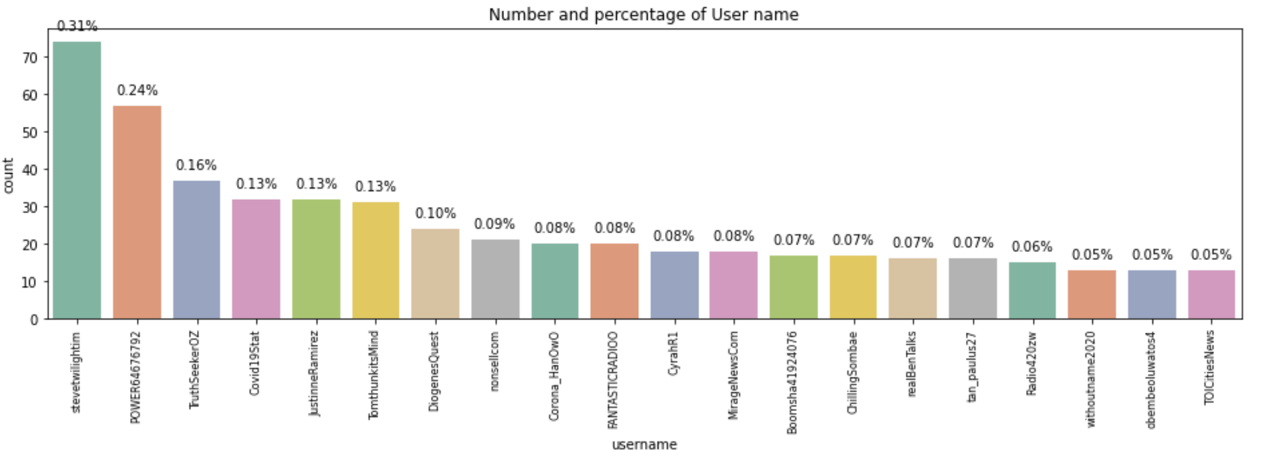
Tweet distribution
I. Exploratory Data analysis | II. Topic Modeling | III. Sentiment Analysis
Frequently tweeted users
Frequently tweeted users’ location
Notes:
Here is a graph shown the frequently tweeted users and the frequently tweeted users location. However, more precise info is provided in the map above

Slide 8
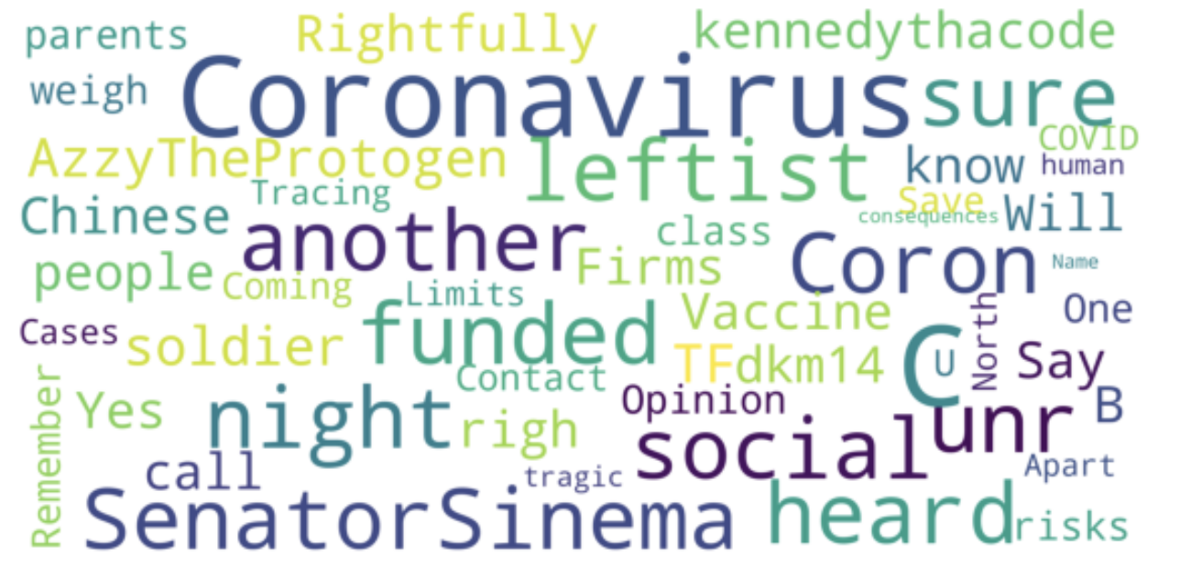
Word Cloud of tweets
I. Exploratory Data analysis | II. Topic Modeling | III. Sentiment Analysis
Notes:
Here is a basic overview of the frequent words in our dataset. As you can see in the graph, there are some meaningless phrases, which need to be further cleaned using the nlp packages

Slide 9
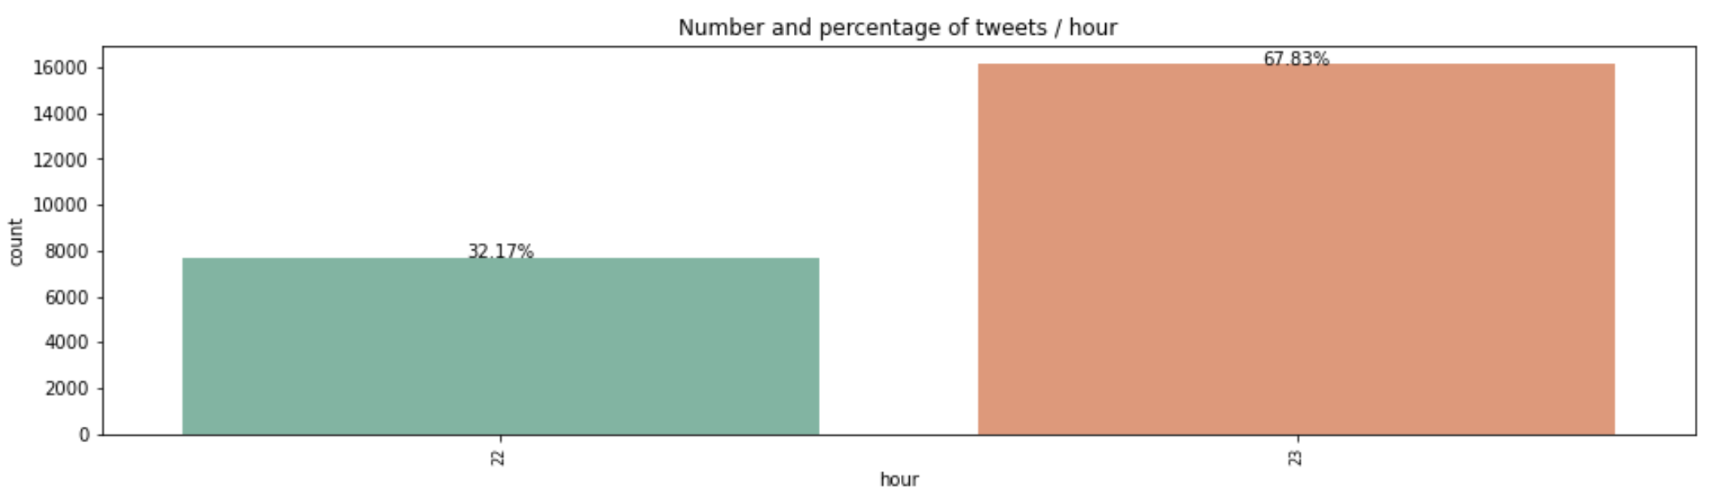
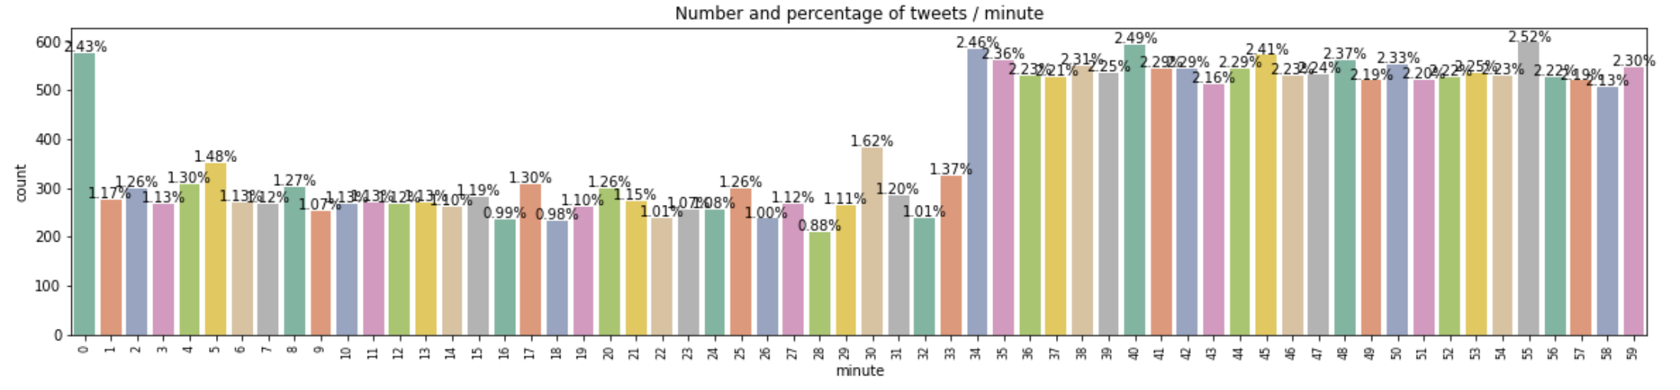
Time of tweets
I. Exploratory Data analysis | II. Topic Modeling | III. Sentiment Analysis
By hour
By minute
Notes:
Since we only have 2 hour’s data, we show the percentage as much as we can. We can also apply the same method when facing the larger dataset.

Slide 10
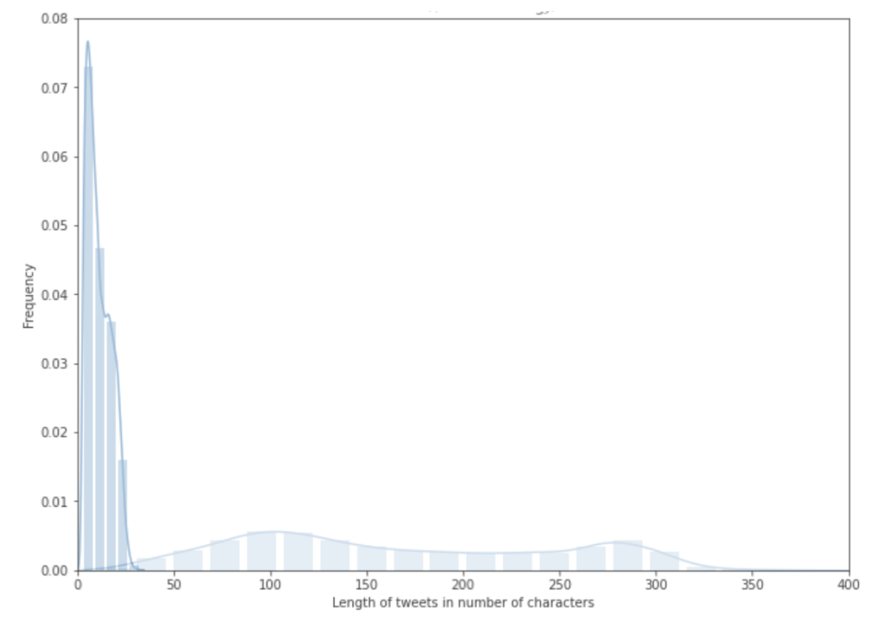
Step 1. TExt cleaning
I. Exploratory Data analysis | II. Topic Modeling | III. Sentiment Analysis
Drop duplicates
Lowercase
Remove:
Hashtags
Users
Links
Synonyms of ‘covid’ (eg. corona)
Special characters
Words with length <= 3
Stopwords
Tweets with tokens <= 3
After cleaning
Before cleaning
Notes:
For topic modeling, the first thing we did was to clean the text. This included dropping duplicates as people often retweet on Twitter, and then converting all text to lowercases. There were also a couple of things we removed and to visualize how this step transformed our data, the graph on the right shows the distribution of the length of tweets measured in number of characters. Before cleaning, the length extended from 0 to 350, and after cleaning, this number was reduced to less than 50. And as an example, in the table above, we are showing one of the tweets. Originally, we had a long text with numbers, hashtags, links, etc, which were removed and the tweet is being tokenized into a list of words.

Slide 11
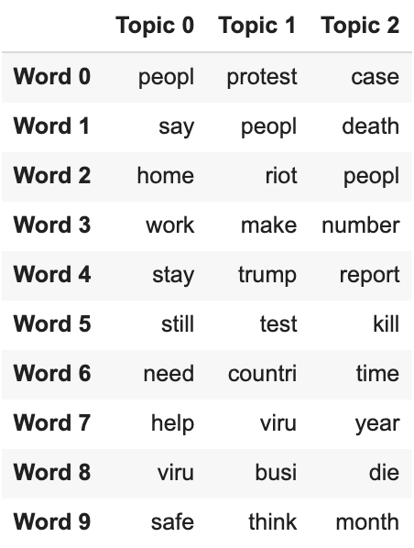
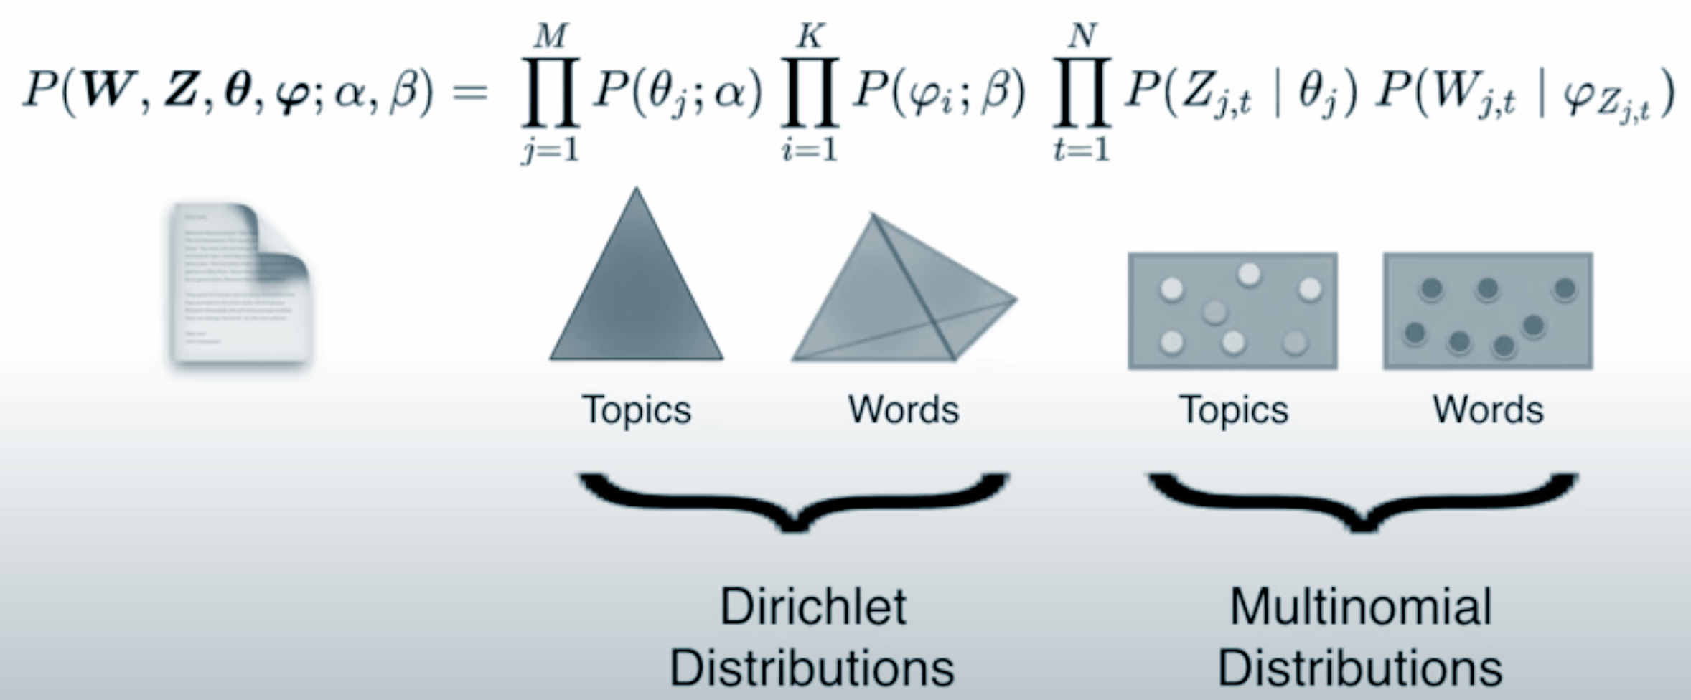
Step 2. Latent Dirichlet Allocation (LDA)
I. Exploratory Data analysis | II. Topic Modeling | III. Sentiment Analysis
Bigrams, Lemmatization, Stemming
Assign a topic to each tweet
Get top keywords for each topic
Topic 0: staying home & working remotely
Topic 1: Trump administration & protests
Topic 2: death number & covid cases
Notes:
After tokenization, we derived bigrams and did some text normalization like lemmatization and stemming to further clean up our data. So this table continues as you can see the effects of each step for that specific tweet. After that, we built a model using LDA in order to assign a dominant topic to each tweet. To briefly show how this model worked, we have this diagram on the left. There are 4 parameters, α and β follow the Dirichlet distribution. α is the interaction btw documents and topics. Since we want 3 topics, they are represented by the 3 vertices of the triangle, and the documents would fall into that area. β is the interaction btw topics and words. The tetrahedron is a simplified representation if we have just 4 words, and the topics would fall into that volume. And the other 2 parameters explain the probabilities of the topics and words, and they follow the multinomial distribution. After running the model, we were able to get this topic & keyword table as shown on the right. For each topic, we extracted the top 10 words. Based on our educated guess, topic 0 is about staying home, topic 1 is about the protest, and topic 2 is about the number of death,

Slide 12
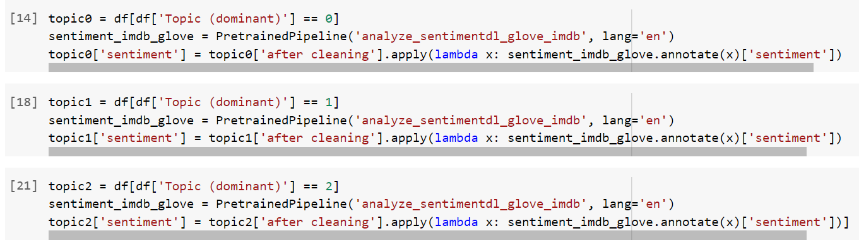
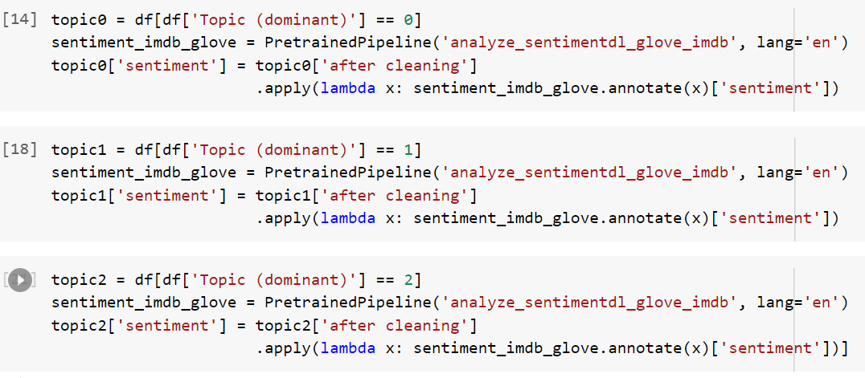
Sentiment analysis
I. Exploratory Data analysis | II. Topic Modeling | III. Sentiment Analysis
Tools Used
SparkNLP Package
Sentiment_imdb_glove PretrainedPipeline
Notes:
To conduct the sentiment analysis, we utilized the Spark nlp package with the Pretrained Pipeline. We Passed the tweets under each topic into the method, which returned back either a negative, positive, or neutral sentiment for each tweet as a result

Slide 13
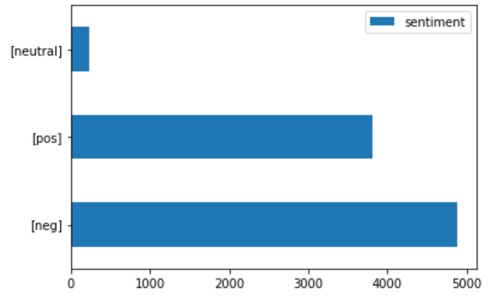
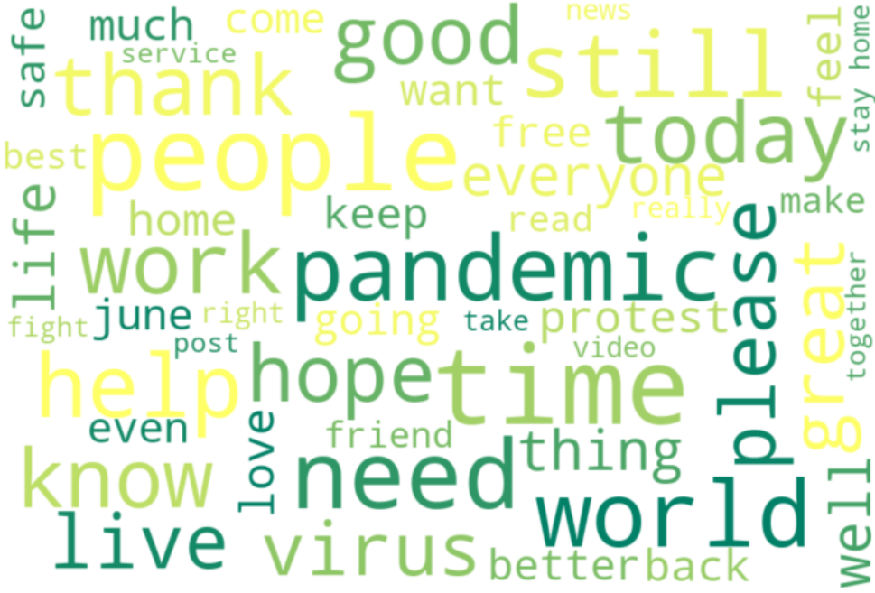
TOpic 0: staying home & working remotely
I. Exploratory Data analysis | II. Topic Modeling | III. Sentiment Analysis
BarChart with All Sentiments
Word Cloud for Positive Tweets
Notes:
Let’s take a closer look to the sentiment analysis results.
The barchart above shows the value counts of each sentiment for Topic 0, we can see that negative tweets are dominating under this topic. But there is also a relatively similar proportion of tweets are expressing positive emotions. Topic 0, based on the results of our topic modeling, is mainly about [staying at home]. We inferred that although people are negative towards covid in general, many of them also have a faith and hope that staying at home can help with that. We can also see that from the word cloud for positive tweets under topic 0 on the right

Slide 14
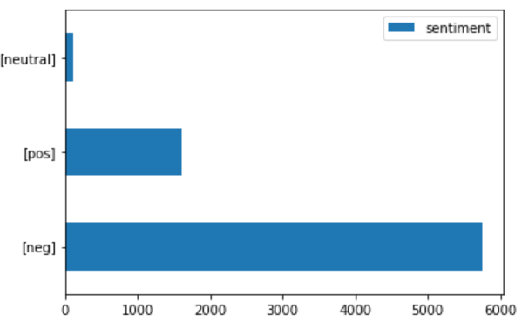
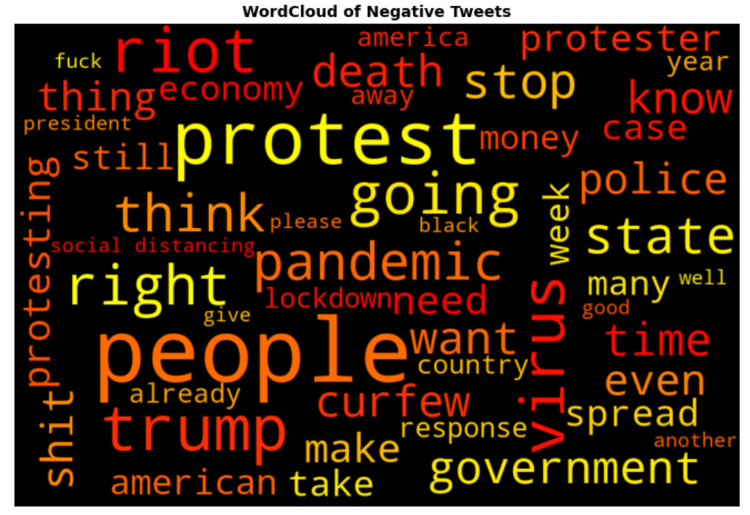
TOpic 1: Trump administration & protests
I. Exploratory Data analysis | II. Topic Modeling | III. Sentiment Analysis
BarChart with All Sentiments
Word Cloud for Negative Tweets
Notes:
Moving to the next topic. There are much more negative tweets than positive or neutral tweets under this topic, and from the word cloud of negative tweets we can see dominant words such as protest, people, riot, curfew, trump, which is also consistent with our topic modeling result of this topic

Slide 15
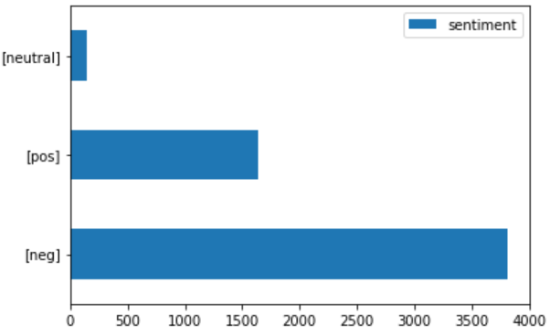
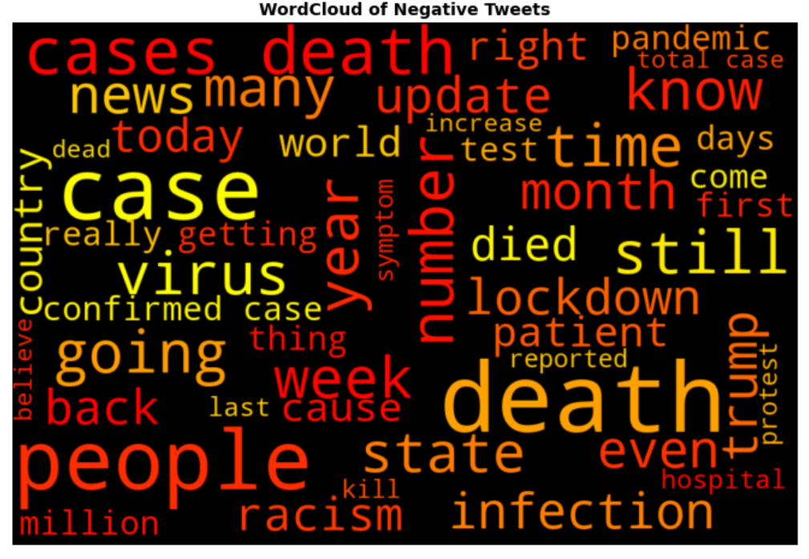
TOpic 2: death number & covid cases
I. Exploratory Data analysis | II. Topic Modeling | III. Sentiment Analysis
BarChart with All Sentiments
Word Cloud for Negative Tweets
Notes:
The value counts bar chart looks similar for our last topic, which is about the death cases. People are more negative than positive when tweeting about the polling results, and it is also consistent with the word cloud on the right

Slide 16
SUmmary
Insights
People tend to have a negative attitude towards Covid in general
Riot, poll numbers, etc.
Policy-related tweets tend to have a relatively higher positive sentiment proportion compared to other topics
Topic 0 has the most proportion of positive sentiments
Major topic is not only related to Covid
While Covid is an ongoing long-term event, people’s discussion is also strongly impacted by other big real-time events
Future suggestions
Need more data from a larger time range
Might get a more accurate sentiment score with John Snow health-analytics-specific package
Notes:
So what do we learn from all these analysis.
We found that although people tend to have a negative attitude towards covid in general, especially towards the riots and death cases related to it, they also tend to show positive sentiment towards policy-related tweets. Just like what we found from the barchart of topic 0 previously, a relatively large proportion of people are tweeting positively about the staying at home policy.
We also found from the second topic that tweets are not only about covid. Although covid is an ongoing long-term event, people’s discussion is also strongly impacted by and related to other big real-time events. And in our case, this event is the black lives matter event.
Besides those discoveries, we also have some suggestions for future study. Firstly, our current dataset only covers tweets from one single day (which is may thirty first 2020). If we have more data from a larger time range, our topics would be more representative and diverse. Secondly, we didn’t use the john snow health analytics specific package because we were having trouble importing it into colab and didn’t have enough time to further work on it. Since our tweets are mainly about covid, the package could possibly provide us with more accurate sentiment analysis results.
That’s all for our presentation. Thank you for listening. We are now open to any questions you might have

Slide 17
Thanks

Slide 18
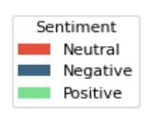
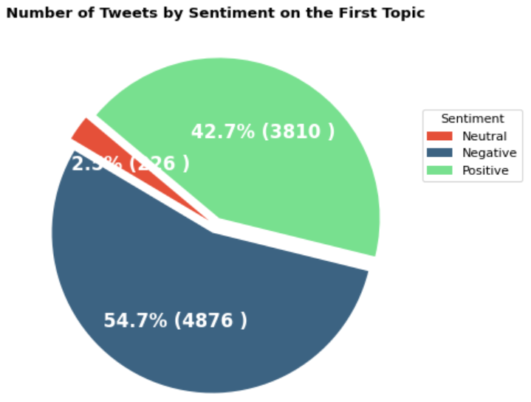
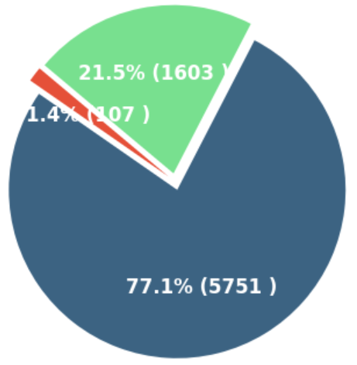
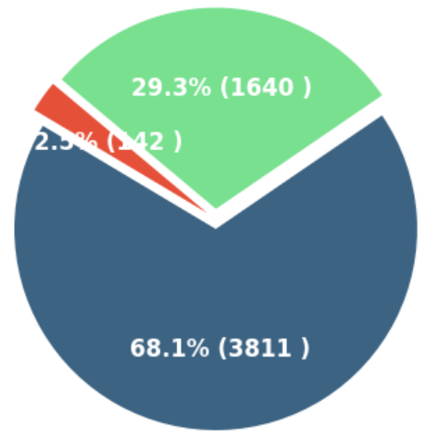
Appendix -- Sentiment Proportion
Topic 0
Topic 1
Topic 2

Slide 19
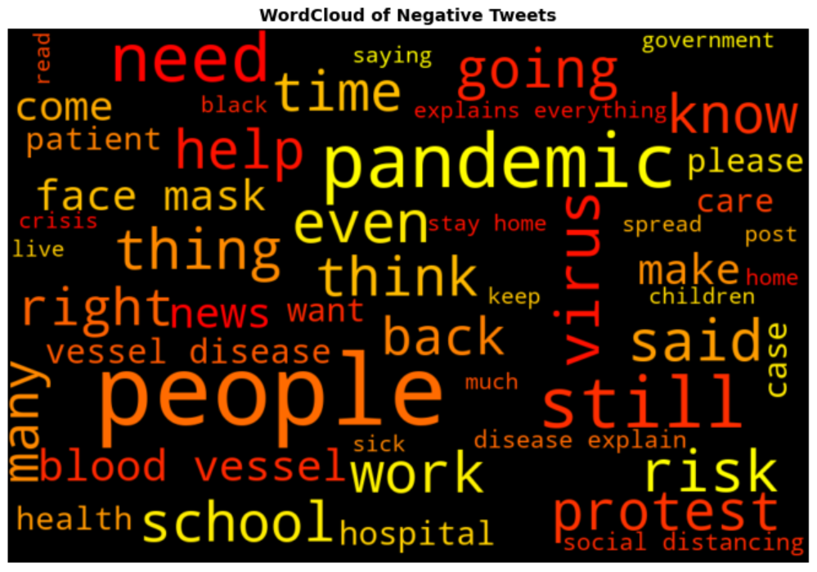
Appendix -- Sentiment Proportion
Negative word cloud for topi 0

Slide 20
References
https://colab.research.google.com/github/JohnSnowLabs/spark-nlp-workshop/blob/master/tutorials/Certification_Trainings/Public/1.SparkNLP_Basics.ipynb#scrollTo=U8AXeuY0_9hx
https://ourcodingclub.github.io/tutorials/topic-modelling-python/
https://towardsdatascience.com/religion-on-twitter-5f7b84062304
https://github.com/HurmetNoka/religion_on_twitter
https://www.youtube.com/watch?v=T05t-SqKArY
https://towardsdatascience.com/topic-modeling-and-sentiment-analysis-on-amazon-alexa-reviews-81e5017294b1

